Slide 1

EDA On Magic Bricks
Presented By:
Pranshu Pardeshi

Slide 2
About me
Educational Background : Bachelors of Computer Application (2025).
Want to learn Data Science because it allows me to turn raw data into meaningful insights that can solve real-world problems. In today’s digital world, data is everywhere, and I’m interested in understanding patterns, trends, and making data-driven decisions rather than relying on assumptions.
Experience : No
Linkdin : https://www.linkedin.com/in/pranshu-a-p-a9b3a3271/
Github: https://github.com/pranshupardeshi0626

Slide 3
Business Problem
The real estate market lacks transparency, making it difficult for buyers, sellers, and investors to determine the fair price of a property. Property prices vary significantly based on factors such as location, square footage, number of bedrooms (BHK), and amenities.
The goal is to analyse housing data to identify key factors affecting property prices and build insights that help stakeholders make data-driven decisions.

Slide 4
Use Cases
1. Price Prediction :
Estimate the price of a property based on features like BHK, location, square foot, and amenities.
Helps buyers and sellers decide a fair price.
2. City-Based Insights :
Analyse how property prices vary across different cities.
Helps users identify expensive vs affordable cities.
3. Real Estate Investment Decisions :
Identify high-growth areas and profitable investment opportunities.
Useful for investors to maximize returns.

Slide 5
Objectives
To understand the relationship between property features (BHK, square foot, City) and price.
To clean and preprocess the dataset by handling missing values and outliers.
To identify important variables that impact housing prices.
To perform exploratory data analysis (EDA) to uncover patterns and trends.
To visualize data for better interpretation and insights.
To support buyers, sellers, and investors with actionable insights.

Slide 6
Web Scraping
Website Used:
Data was collected from Magic Bricks (house buying website)
URL :- Real Estate | Property in India | Buy/Sale/Rent Properties | MagicBricks
Tools & Technologies:
Requests (for sending HTTP requests)
BeautifulSoup (for parsing HTML data)
Process Followed:
Sent request to the website using Python
Collected HTML content of web pages
Parsed the data using BeautifulSoup
Extracted required fields (society_name, bhk,sqft,price etc.)
Stored the data into a structured format (DataFrame/CSV)
Cleaned and prepared data for analysis

Slide 7
Summary of Data
Summary of Data
The dataset contains information about multiple cities collected from Magic Bricks
It includes both numerical and categorical features
Key Columns in Dataset:
Price, BHK, Sqft, City, Society Name, Furnished_status.
Data Characteristics:
Mix of structured data (numeric + categorical)
Some missing/null values handled during preprocessing
Data cleaned and converted into usable format

Slide 8
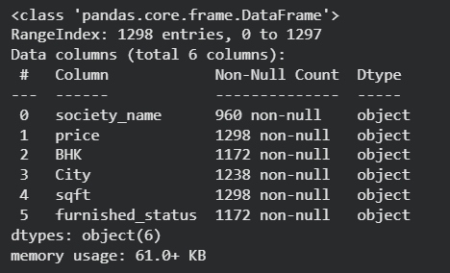
Data Cleaning & Preprocessing
Steps Performed:
Removed missing/null values
Handled inconsistent and duplicate data entries
Converted data type from object to numeric
(e.x : price, bhk, sqft)
Filtered out outliers.
Why Data Cleaning is Important:
Ensures accuracy of analysis
Improves data quality

Slide 9
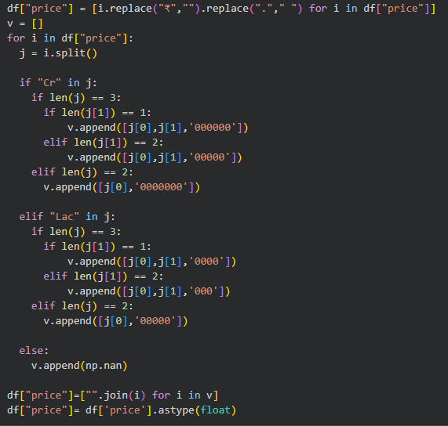
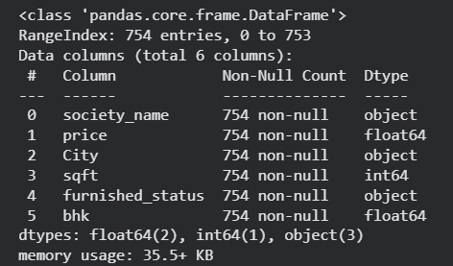
Data Cleaning Steps
For the Price column I replace the special symbol and special character and then added the required zero so that I can convert it into float data type.
Then i used groupby on BHK and City and then filled the null values of bhk with median.
For the furnished status I use forward fill.
For handling the city columns null I checked the data and per per my understanding the null values are between pune and Mumbai so I used range and then fill 50 % with pune and then 50 percent with Mumbai.
For the society name column null values I removed the row itself.
Then Converted the data types of the required columns.
Then removed some outliers using IQR

Slide 10
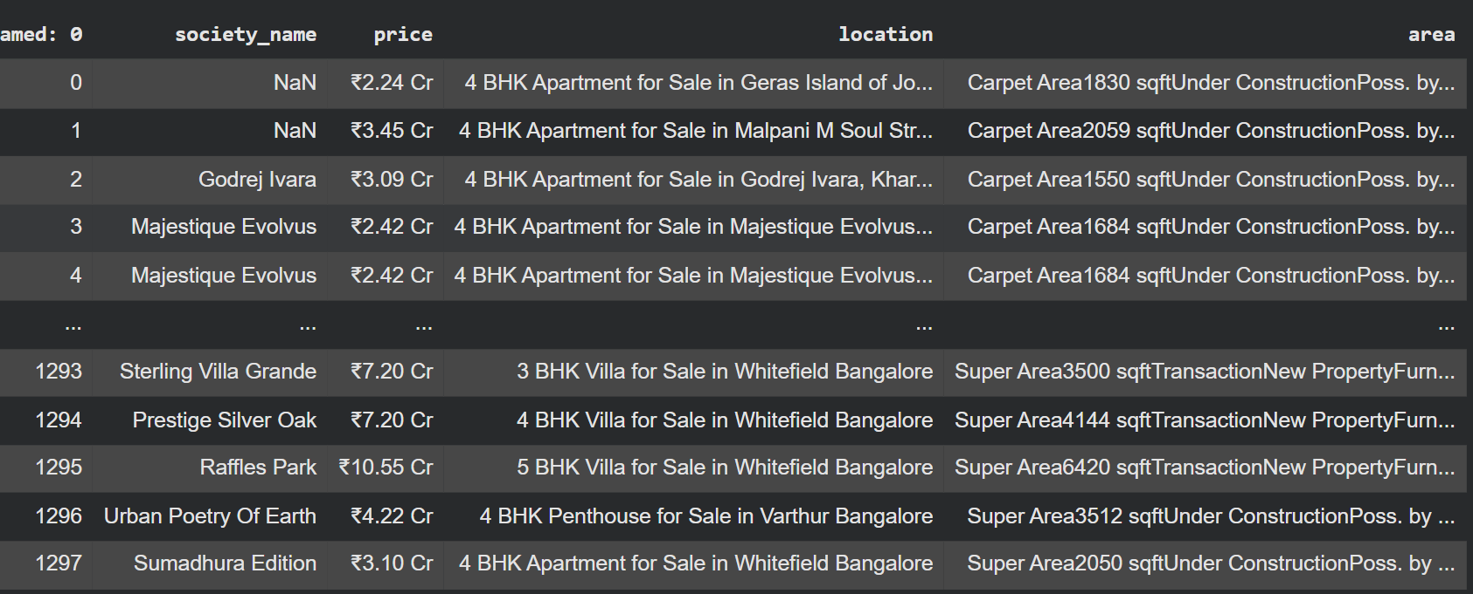
Raw Data

Slide 11
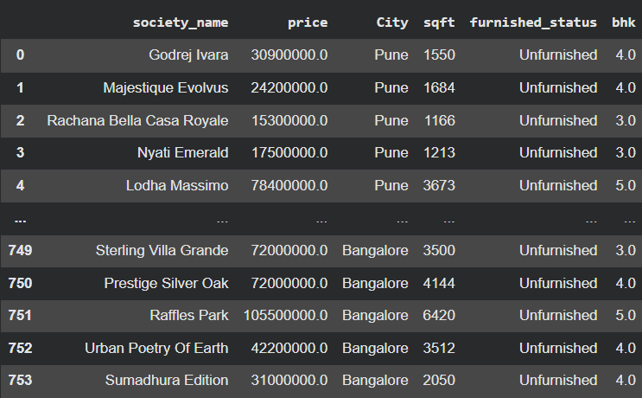
Clean data

Slide 12
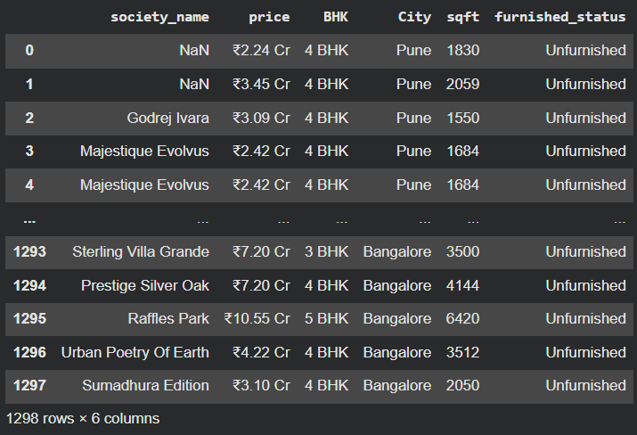
Regex
A regular expression (regex) is a pattern used to search, match, or manipulate
Text based on specific rules.
Applying Regex for Data Cleaning
Ex :- for column name :- (r"Area+\d+“)
Before:
Carpet Area1830 sqftUnder ConstructionPoss. by.. After:
Area1830

Slide 13
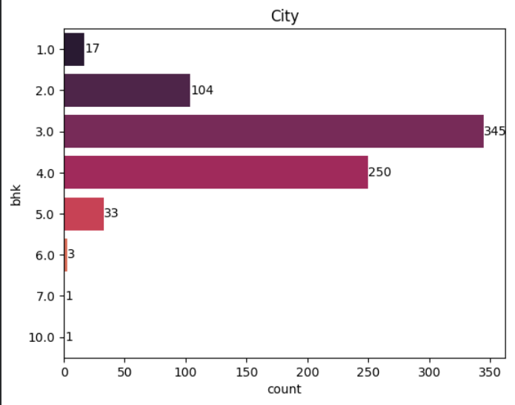
Univariate Analysis
BHK : The BHK is Highly Skewed in the right
1. 3 BHK is the most common
It has the highest count (345 properties).
This means most houses in the dataset are mid-sized homes, preferred by families.
2. 4 BHK is the second most popular
Around 250 properties.
Indicates demand for larger homes, likely for bigger or premium families.
3. 2 BHK also has significant presence
Around 104 properties.
Common for small families or budget buyers.
4. 1 BHK is very limited
Only 17 properties.
Shows low availability or demand for very small houses.
5. Luxury or very large homes (5+ BHK) are rare
5 BHK: 33
6 BHK: 3
7 & 10 BHK: only 1 each
These are high-end or luxury properties, so naturally fewer in number.

Slide 14
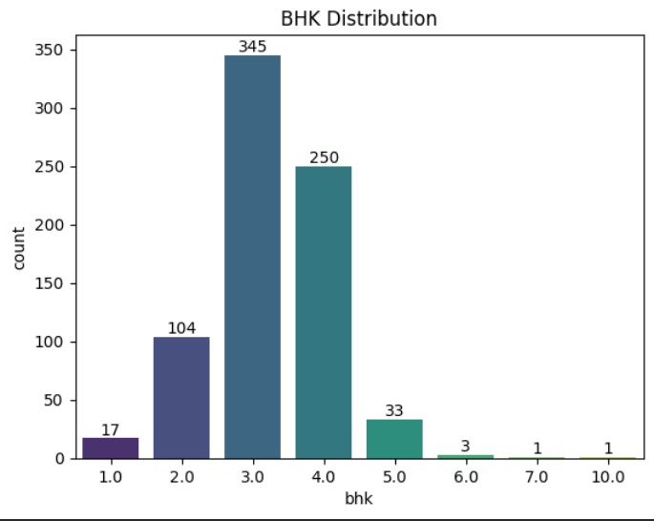
BHK Distribution
3 BHK dominates the market
4 BHK is also very popular
2 BHK has moderate availability
1 BHK is very low
Luxury segment (5+ BHK) is rare

Slide 15
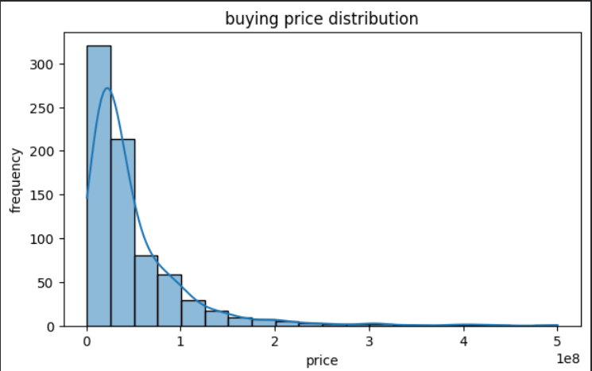
Data Distribution
The Data is Right skewed Data.in the data Most Houses are from 1cr to 10 cr around 350 flats are 1 cr to 2 cr.
So according to these we can find out that 1 cr to 2 cr are affordable that’s why there availaibility is more.

Slide 16
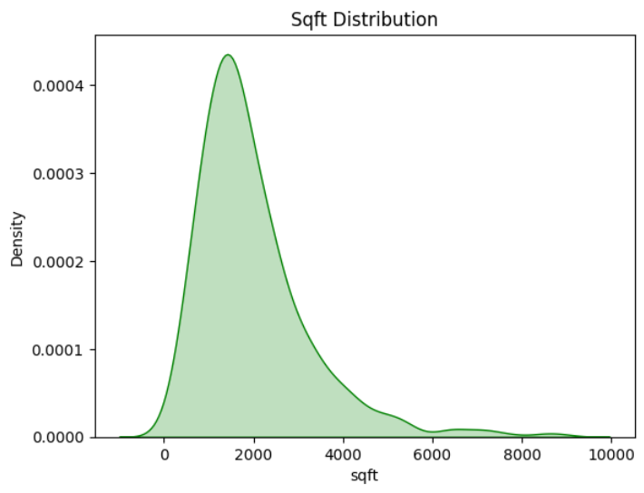
Distribution by sqft
1. Most properties are between 1000–2000 sqft
The peak (highest point) is around this range
This is the most common property size.
2. Right-skewed distribution.
The curve is skewed to the right.
Meaning there are few very large properties (outliers).
3. Large properties are rare.
Beyond 4000–5000 sqft, density drops sharply.
Indicates luxury or premium homes are limited.
4. Long tail towards higher sqft .
Extends up to 10,000 sqft.
Shows presence of extreme values/outliers.

Slide 17
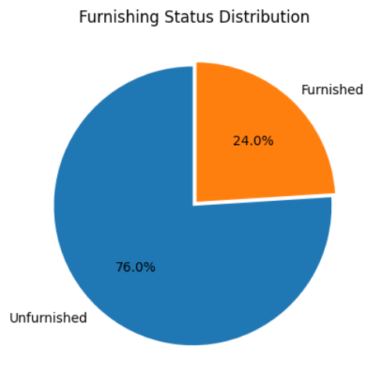
Data Distribution by Furnished and Unfurnished
Key Insights
Dominant Category: The majority of properties are Unfurnished, accounting for 76.0% of the total data.
Minority Category: Only 24.0% of the properties are Furnished.
Ratio: There are approximately 3 un-furnished properties for every 1 furnished property in this dataset.

Slide 18
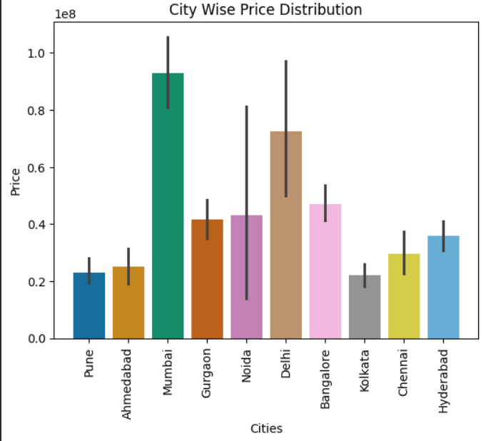
Bivariate Analysis
City Wise Price Distribution
Mumbai has the highest average property price (~9 Crore).
Kolkata is the most affordable city in the dataset.
Delhi and Noida show the widest price fluctuations between listings.
Pune and Ahmedabad offer the most consistent, stable pricing.

Slide 19
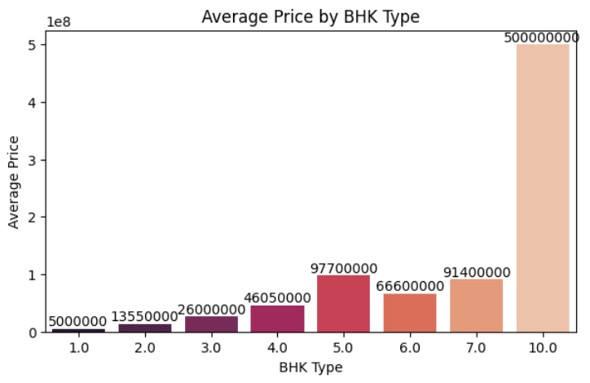
Average Price by BHK
General Upward Trend: There is a clear positive correlation between the number of bedrooms and the average price. As the BHK type increases, the cost generally rises.
The 10 BHK Anomaly: The 10.0 BHK category shows a massive spike to 500,000,000.
Dips in Data: Surprisingly, the 6.0 BHK average is lower than the 5.0 BHK average. This could suggest that the 6 BHK properties in this dataset are in less desirable locations or have smaller overall square foot than the 5 BHK units.

Slide 20
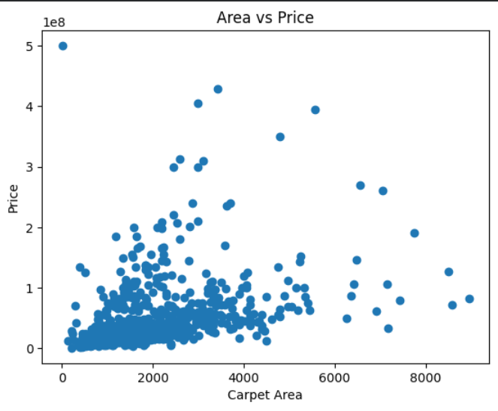
Relation Between Area and Price
General Trend: As the Carpet Area (x-axis) increases, the Price (y-axis) generally tends to rise as well. Most data points move from the bottom-left toward the top-right.
Correlation Strength: It is a moderate positive correlation.

Slide 21
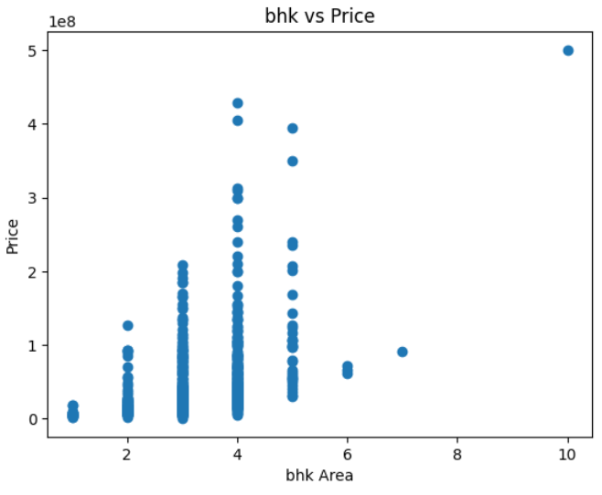
BHK Vs Price Distribution
Positive Trend: There is a general upward trend. As the number of bedrooms increases from 1 to 5, the maximum potential price also increases.
Price Volatility: Notice that for 3, 4, and 5 BHK properties, the vertical "columns" are very long. This means that having 4 bedrooms doesn't guarantee a high price; some are very cheap, while others are extremely expensive.

Slide 22
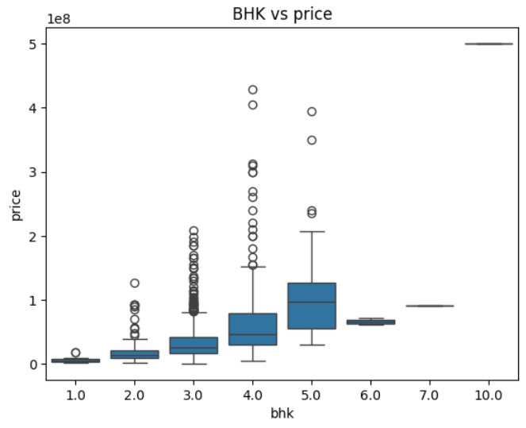
Price Escalation: The median price (the line inside each box) increases consistently from 1.0 BHK to 5.0 BHK, confirming a strong positive relationship.
Increasing Variance: As the number of rooms increases, the "height" of the boxes (the Interquartile Range) grows. This means that while a 1 BHK price is very predictable, a 5 BHK price is highly variable.

Slide 23
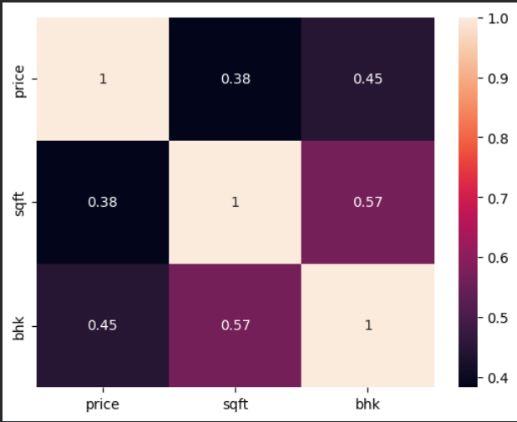
Multivariate Analysis
Strongest Relationship (BHK vs. sqft: 0.57):
There is a moderate-to-strong positive correlation between the number of bedrooms and total area.
This is logical: as you add more bedrooms, the total square foot of the house typically increases.
Price vs. BHK (0.45):
This is a moderate positive correlation.
It indicates that while more bedrooms generally mean a higher price, it isn't the only factor. Factors like luxury finish or location likely play a large role here as well.
Price vs. sqft (0.38):
This is the weakest positive correlation in the matrix.
Surprisingly, in this specific dataset, the number of bedrooms (BHK) is a slightly better predictor of price than the total square footage.

Slide 24
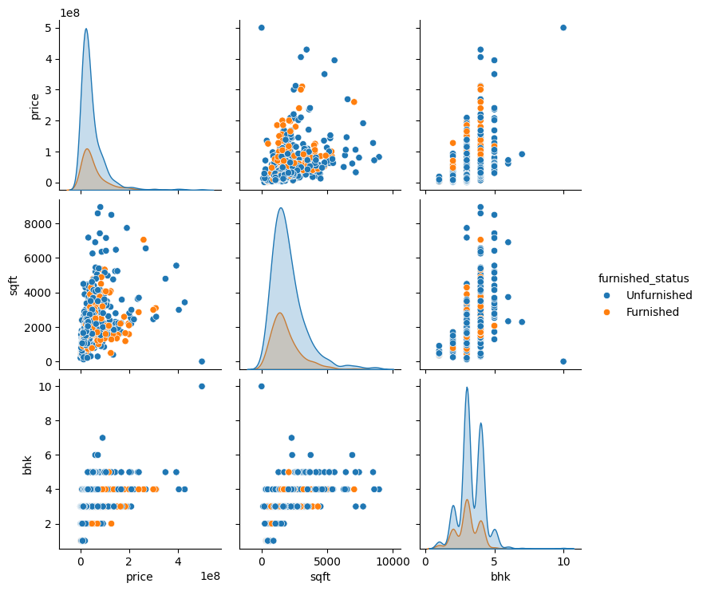
Distribution Overlap (Diagonal KDE Plots):Price: Unfurnished properties (blue) have a much higher peak at the low-price end. This suggests the "entry-level" market is almost entirely unfurnished.
Sqft: The distributions are very similar, meaning being furnished or unfurnished doesn't strictly depend on the size of the house.
BHK: Unfurnished properties dominate the 2, 3, and 4 BHK categories. Furnished homes are more evenly (but sparsely) spread across these types.

Slide 25
Challenges Faced
Difficulty in extracting data due to website structure during web scraping.
Handling missing and inconsistent data values.
Converting price and bhk data into proper numerical format.
Managing extreme outliers in data (price).
Identifying meaningful insights from complex multivariate relationships

Slide 26
Conclusion
While factors like furnishing status and square footage are usually important.
this dataset shows they are not reliable predictors of property prices.
There is a slight positive relationship between the number of bedrooms (BHK) and the cost, but the high level of price variation makes it impossible to accurately predict values based on these features alone.

Slide 27

THANK YOU

